Slide 1
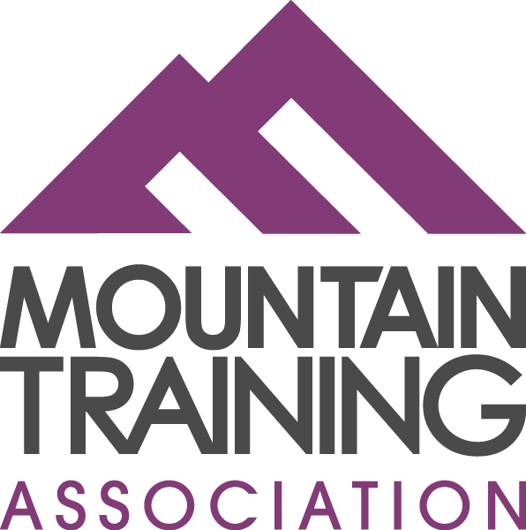

Slide 2

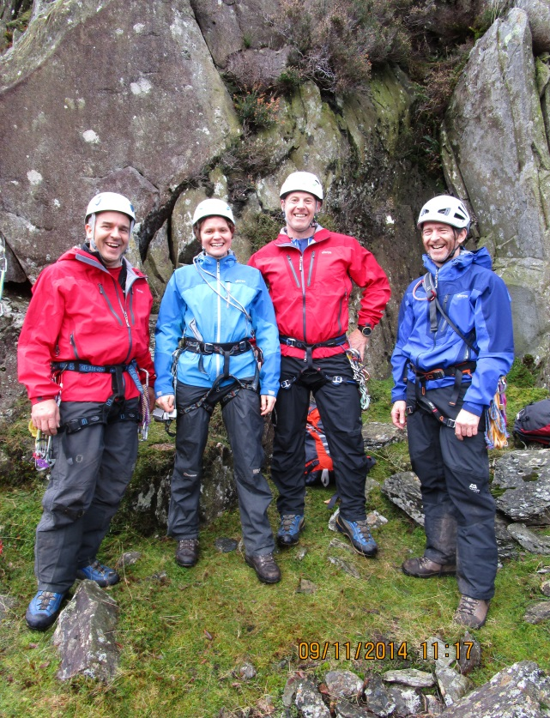


A Membership organisation providing support and development opportunities
for all candidates of Mountain Training.
What is the Mountain Training Association?
A membership organisation providing support and development opportunities for all candidates of Mountain Training
Notes:
The Mountain Training Association (MTA) was established in 2005 to provide ongoing support and development opportunities to candidates of Mountain Training. It was also intended to maintain a link between the candidates and Mountain Training beyond obtaining their award and for the rest of their outdoor career.
MTA currently has approximately 4200 members (Dec 15) who come from a wide variety of backgrounds- some people work full time in the outdoors, some volunteer with Schools, Guides and Scouts, and some people are simply pursuing the awards and interested in mountain training for purely personal reasons. The Association aims to offer something to all of these people. Because of the nature of the Boards which contain representatives from all these walks of life, we are well placed to understand members’ needs.
Membership is open to people registering for one of the Mountain Training’s National Awards which includes the Climbing Wall Award (CWA), Climbing Wall Leaders Award (CWLA) Single Pitch Award (SPA), Lowland Leader Award (LLA), Hill and Moorland Leader {HML) Mountain Leader Summer and Winter and those on the Coaching Award Scheme.
Many higher level award holders also choose to be members of the Association and along with course directors support the Continued Personal Development programme.

Slide 3
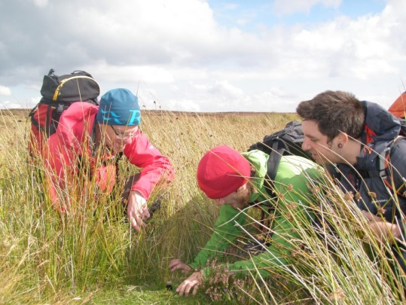
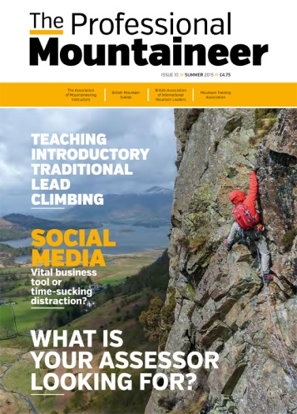
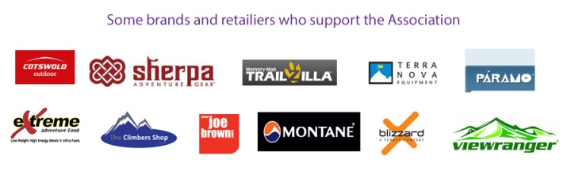
A Membership organisation providing support and development opportunities
for all candidates of Mountain Training.
What the Mountain Training
Association offers:
Consolidation opportunities
Continued Personal Development
The Professional Mountaineer
Civil liability insurance
Members’ deals and discounts
workshops, regional events, networking opportunities, online resources
Notes:
The Mountain Training Association (MTA) offers ongoing training opportunities through a programme of workshops which include technical skills, environmental, geology, disability awareness and GPS to name but a few
A specially negotiated rate for Civil Liability Insurance for members working in the outdoors. It is very good value and is based on the remit of the awards in the UK.
Members receive a monthly e-newsletter keeping you up to date and a quarterly magazine The Professional Mountaineer with inspiring articles and information.
The Association has an active website www.mountain-training.irg/mta and a members area providing access to online resources, forum, jobs and opportunities, deals and discounts. Etc.
The discounts and deals are from a range of manufacturers and retailers Including a pro-deal with Sherpa and Montane and 20% of at Cotswold. Discount (s) are also offered on courses, books, mapping and accommodation.
The Association is a great community and network of outdoor leaders and instructors, it’s a good way of staying in touch with Mountain Training. It provides opportunities to get members together, discuss and share ideas, ask questions and provide support and mentoring to other members.

Slide 4

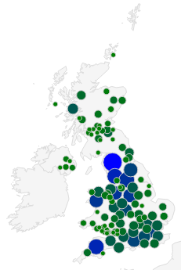
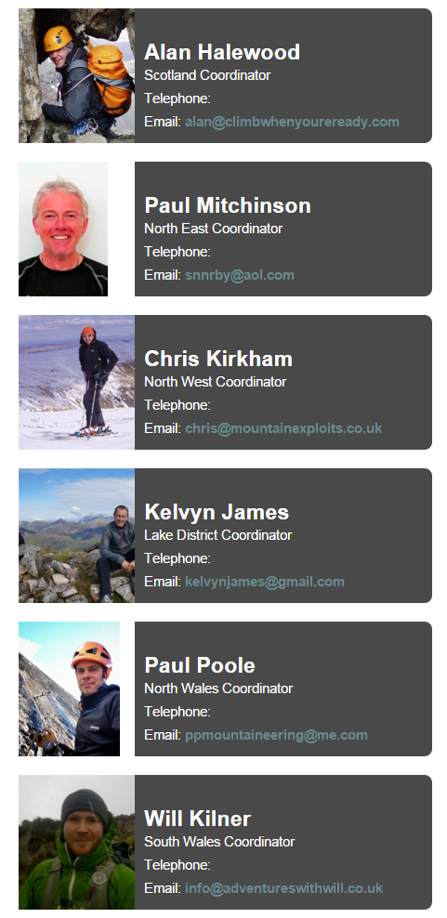
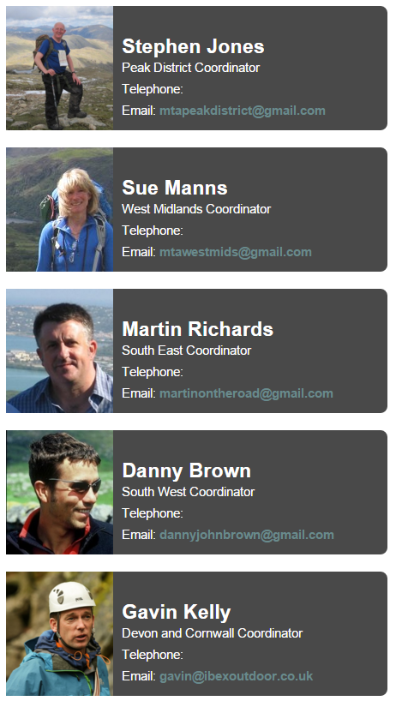
Regional groups
Notes:
Membership of the Association is growing and members are spread right across the UK, (see diagram above) In order to provide a better network of support and more local opportunities we currently have 11 regional groups.
Each group has a volunteer regional coordinator organising local events and peer learning opportunities for members to get together practise skills and share ideas and experiences. These events are also great opportunities for full members to support trainees working towards their awards as a form of mentoring.
To find out what is coming up in your area, or if you have an area of expertise that you would like to share with other members as a regional event then get in touch with your regional coordinator who will be happy to hear from you.
We are always looking to provide new and interesting workshops and are open to suggestions from members.

Slide 5

How to join
Log in to the Candidate Management System
Go to the Membership tab within your account
Pay £32 to joint the Mountain Training Association
NB. Registering for a Mountain Training Scheme and having an account on the system is not the same as joining the Mountain Training Association.
.
Notes:
Membership of the Mountain Training Association is open to candidates of Mountain Training at the point of registering for an Award Scheme.
It is a common mistake for candidates to think they are members of the Association because they have registered for an award.
Membership to the Association is separate from registration and involves an annual fee of £32. The cost of which is easily re-cooperated with the savings you’ll make on our gear deals alone.
Because of its aims the Association is particularly beneficial once you have completed training and for the rest of your outdoor career, whether you volunteer, are employed or freelance.
You can check your membership status, join and renew by logging into CMS, select Account and go to the membership tab.
Members will receive an email notification when their membership is due for renewal.

Slide 6
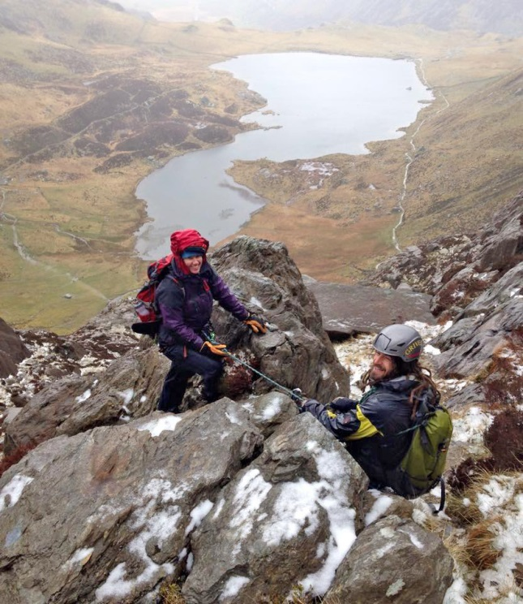
Full members
Full members have the following additional benefits:
Online record of accredited Continued Personal Development
Use of the Association logo to promote yourself
Listing and profile on Find a Leader
Notes:
A full member of the Association is one that has been assessed and holds at least one of Mountain Training’s Awards .
Full members of the Association have the facility to record their Continued personal development online enhancing their public profile.
They can download and use the Mountain Training Association logo to promote themselves by following the guidelines in the Logo policy.
Full members can list themselves and the areas that they work on the Find a Leader facility. This includes a personal profile where they can describe their business, skills and services, including contact details and a link to their website.

Slide 7
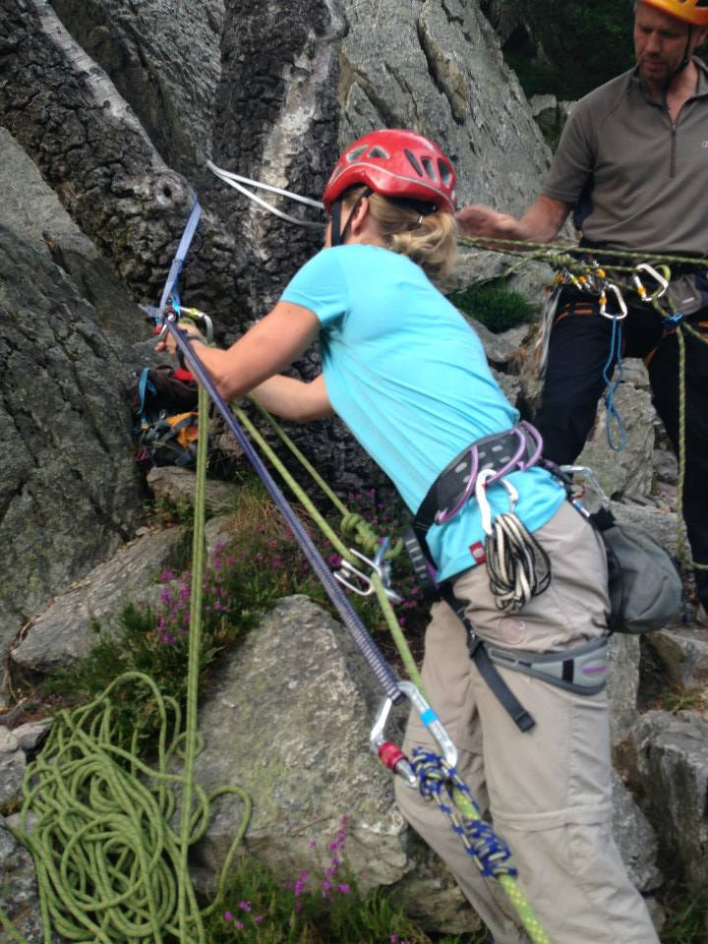
Continued Personal Development
The Association has a Continued Personal Development Policy for full members which includes:
A minimum of 2 points + 20 days/sessions +
First aid
Every 5 years from passing your first award
Notes:
Part of being a full member of the Association includes keeping up to date with Continued Personal Development. The policy states that members need to have a minimum of 2 points along with 20 days or sessions every 5 years from passing their first award. It also requires members to be in date for First Aid.
The points can come from a host of events, courses and workshops. As well as the workshop programme on CMS, we have accredited many external courses, workshops and conferences such as employers in-house training, DofE Train the Trainer, courses run by the Institute of Outdoor Learning and BMC disability symposium as examples. These are listed under the CPD tab in CMS and members can add these to their records themselves.
The 20 days/sessions can include both group and personal days/session and can be a mixture relevant to the awards that they hold. By keeping DLOG up to date members are keeping their CPD record up to date also.
For members who hold more than one award and or are working full time in the outdoors it is quite common to have more than the minimum and this is encouraged to keep up to date with good practise across the awards.

